Slide 1
Python Interpreter Comparison
Cpython / Pypy / Jython / IronPython
Haowen Zhang / Chang Lu

Slide 2
Python Interpreter
Our Contribution
CPython
PyPy
Jython
IronPython
…
We collect a benchmark for four Interpreters, profile and compare the performance of them.
Elapsed time, CPU time, Memory usage, CPU load

Slide 3
Implementation
Problem
Both Windows and Linux platform
Psutil package
Subprocess Module
Benchmark from https://pybenchmarks.org/
Some Interpreters do not support the package

Slide 4
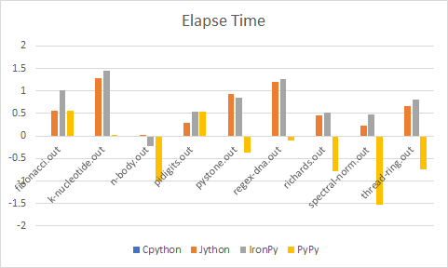
Windows measurement
CPython: Standard
Jython: slow down
IronPython: slow down
PyPy: speed up

Slide 5
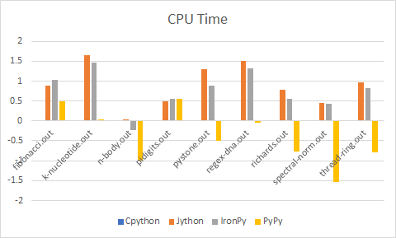
Windows measurement
CPython: Standard
Jython: slow down
IronPython: slow down
PyPy: speed up

Slide 6
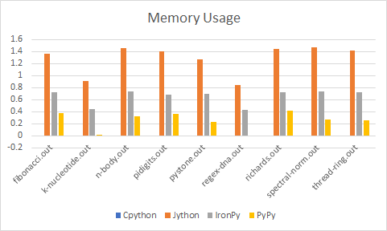
Windows measurement
CPython: Standard
Jython: 20~30 times
IronPython:3~5 times
PyPy: little bit more

Slide 7
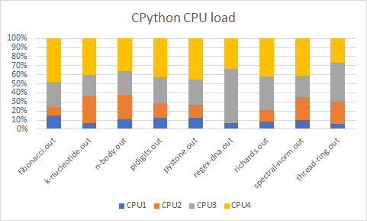
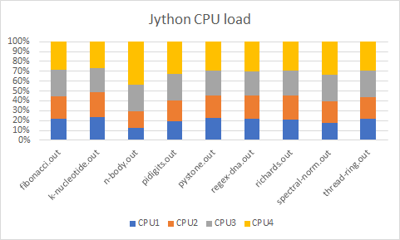
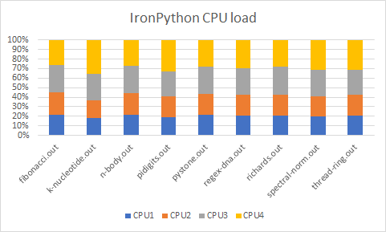
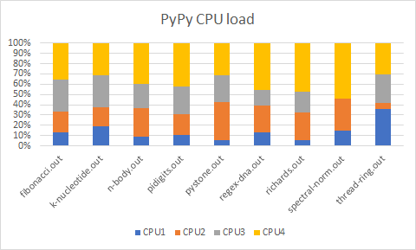

Slide 8
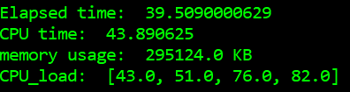
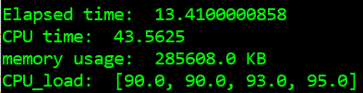
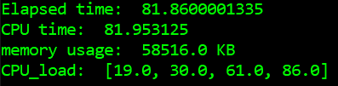
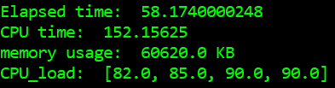
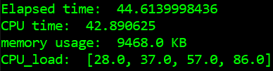
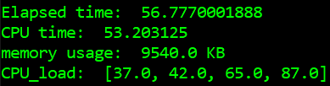
Multi-Thread Performance
Single-Thread Multi-Thread
Jython
IronPy
CPython

Slide 9
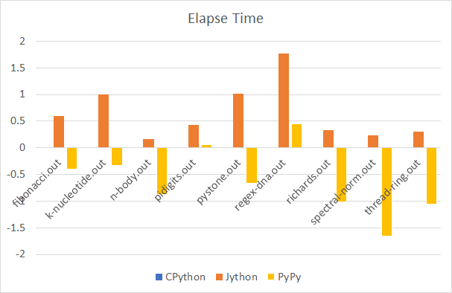
Benchmark on Linux - Elapsed Time
Intel core i5-3317U @ 1.70GHZ*4
4GB 1333MHz memory
Ubuntu 16.04 LTS
CPython: Standard
Jython: slow down
(2~50x slower)
PyPy: speed up for the most of time
(3~50x faster, sometimes 3x slower)
Notes:
Intel core i5-3317U @ 1.70GHZ*4
4GB 1333MHz memory
Ubuntu 16.04 LTS

Slide 10
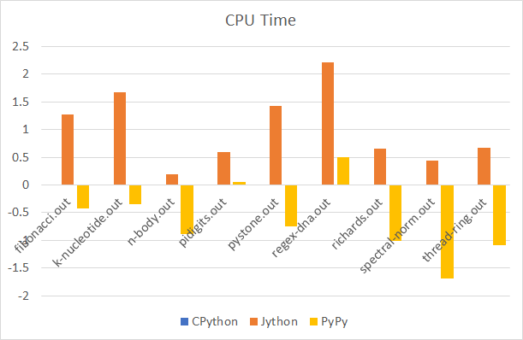
Benchmark on Linux - CPU Time
CPython: Standard
Jython: slow down
(3~100x slower)
PyPy: speed up for the most of time
(3~40x faster, sometimes 3x slower)

Slide 11
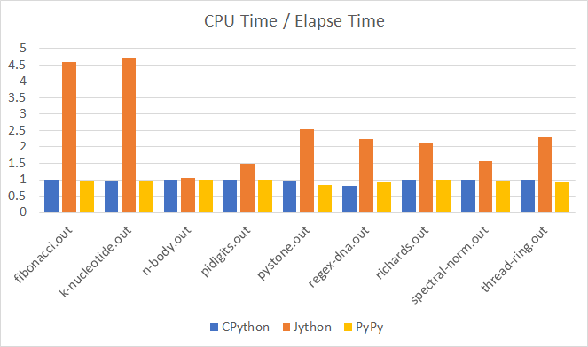
Benchmark on Linux - CPU/Elapsed Time
CPython & Pypy: Cpu time almost equal to Elapsed time
Jython: CPU time is often higher than Elapsed time

Slide 12
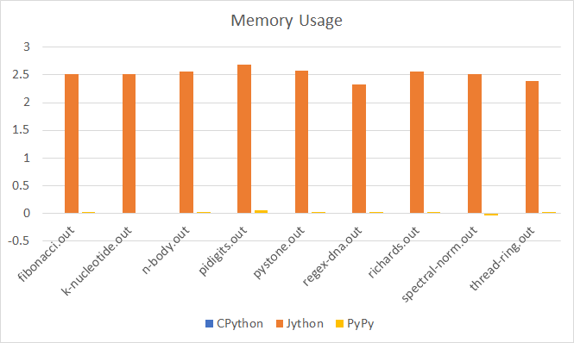
Benchmark on Linux - Memory Usage
CPython & Pypy: 600~1000KB
Jython: ~200-300MB

Slide 13
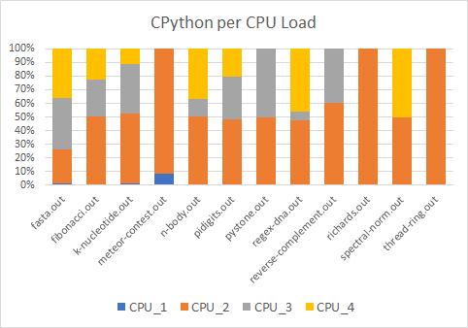
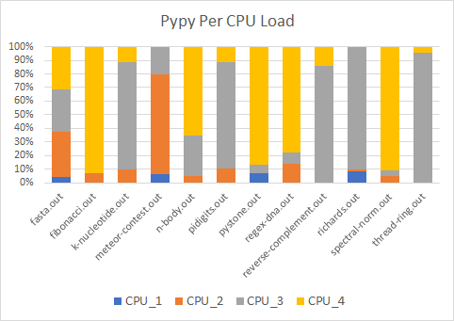
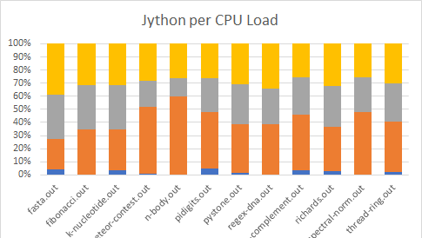
Cpython & Pypy: CPU tasks are unevenly distributed
Jython: CPU tasks distributed more evenly

Slide 14
Multi-Thread Performance
 | Single-Thread | Multi-Thread
Jython | Elapsed time: 6.64108514786 CPU time: 11.11 memory usage: 415416.0 KB CPU_load: [70.0, 98.0, 43.0, 54.0] | Elapsed time: 5.98688197136 CPU time: 14.75 memory usage: 442940.0 KB CPU_load: [75.0, 95.0, 91.0, 79.0]
CPython | Elapsed time: 0.562386989594 CPU time: 0.55 memory usage: 844.0 KB CPU_load: [51.0, 19.0, 98.0, 1.0] | Elapsed time: 0.570235013962 CPU time: 0.56 memory usage: 716.0 KB CPU_load: [3.0, 100.0, 77.0, 26.0]
Pypy | Elapsed time: 0.4260160923 CPU time: 0.2 memory usage: 712.0 KB CPU_load: [21.0, 100.0, 12.0, 15.0] | Elapsed time: 0.166795015335 CPU time: 0.16 memory usage: 740.0 KB CPU_load: [100.0, 100.0, 6.0, 5.0]

Slide 15
Observations
Pypy runs faster than other interpreters in most our tiny test programs
Sometimes Pypy can be slower than Cpython
When running multithreaded programs, Cpython can be even worse.
Jython and IronPython require a lot more memory use during the run time
Cpython and Pypy use ~10x less memory on Linux than on Windows(we still don’t know why)
Notes:
JIT (Just In Time compiler) will dynamically compile some hot sections of bytecode and to machine code
Like fibonacci, pidigits; good at dealing with loops but poor at dealing with recursion?
GIL (Global Interpreter Lock), CPython has a built-in mutex to ensure the thread safe
Start JVM/CLR(common language runtime) require both more memory and longer time to excute. This is a huge overhead. Small programs, proformance will be largely impacted

Slide 16
Next steps
Run large python applications using these interpreters, and compare their performance.
Try to run IronPython on Ubuntu, if time permits.

